Slide 1
DESIGN PATTERNS

Slide 2
Index
Basic concepts of Design patterns
How to select a design pattern
Creational patterns
Structural patterns
Behavioral patterns
Concept of Anti-patterns

Slide 3
Basic concepts of Design patterns
In software engineering, a design pattern is a general repeatable solution to a commonly occurring problem in software design
A design pattern isn’t a finished design
It is a description or template for how to solve a problem that can be used in many different situations

Slide 4
Each design pattern systematically names, explains, and evaluates an important and recurring design in object-oriented systems
Our goal is to capture design experience in a form that people can use effectively
To this end we have documented some of the most important design patterns and present them as a catalog

Slide 5
In general, a pattern has four essential elements:
Pattern name
Problem
Solution
Consequences
Pattern name
Use to describe a design problem, its solutions, and consequences in a word or two
Naming a pattern immediately increases our design vocabulary
It makes it easier to think about designs and communicate to others
Finding good names has been one of the hardest part

Slide 6
Problem
Describes when to apply the pattern
It explains the problem and its context
Solution
The solution doesn't describe a particular concrete design or implementation
Because a pattern is like a template that can be applied in many different situations
Describes the elements that make up the design, their relationships, responsibilities, and collaborations
Consequences
They are the results and trade-offs of applying the pattern

Slide 7
Design patterns can speed up the development process by providing tested, proven development paradigms
Reusing design patterns helps to prevent subtle issues that can cause major problems
Improves code readability for coders and architects familiar with the patterns

Slide 8
Often, people only understand how to apply certain software design techniques to certain problems
These techniques are difficult to apply to a broader range of problems
Design patterns provide general solutions, documented in a format that doesn't require specifics tied to a particular problem
In addition, patterns allow developers to communicate using well-known, well understood names for software interactions
Common design patterns can be improved over time

Slide 9
How to select a design pattern
With more than 20 design patterns in the catalog to choose from, it might be hard to find the one that addresses a particular design problem, especially if the catalog is new and unfamiliar to you
Here are several different approaches to finding the design pattern that's right for your problem:

Slide 10
Consider how design patterns solve design problems
Find appropriate objects, determine object granularity, specify object interfaces, and several other ways in which design patterns solve design problems
Scan Intent sections
Read through each pattern's intent to find one or more that sound relevant to your problem
Study how patterns interrelate
Studying these relationships between design patterns graphically can help direct you to the right pattern or group of patterns

Slide 11
Study patterns of like purpose
Study the similarities and differences between creational patterns, structural patterns and behavioral patterns
Examine a cause of redesign
Look at the patterns that help you avoid the causes of redesign
Eg : Algorithmic dependencies
Algorithms are often extended, optimized, and replaced during development and reuse
Objects that depend on an algorithm will have to change when the algorithm changes
Therefore algorithms that are likely to change should be isolated
Design patterns: Builder, Iterator, Strategy, Template, Method, Visitor

Slide 12
Consider what should be variable in your design
Consider what you want to be able to change without redesign
The focus here is on encapsulating the concept that varies
Design aspect(s) (eg : steps of an algorithm) of design patterns can vary independently, thereby letting you change them without redesign

Slide 13
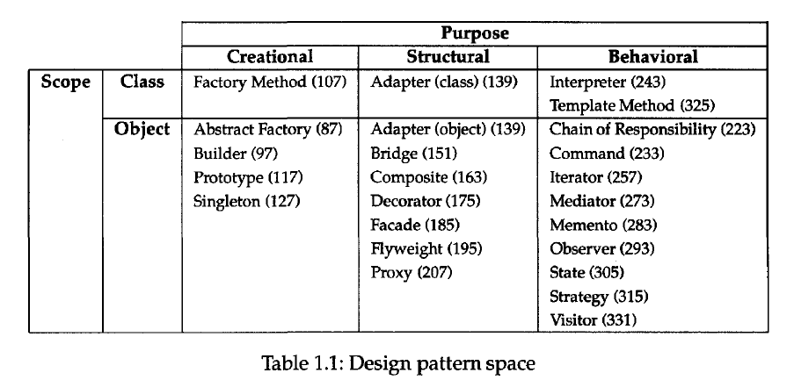
Organizing the Catalog
There are many design patterns, we need a way to organize them

Slide 14
We classify design patterns by two criteria (Table1.1)
The first criterion, called purpose, reflects what a pattern does
Patterns can have either creational, structural, or behavioral purpose
Creational patterns concern the process of object creation
Structural patterns deal with the composition of classes or objects
Behavioral patterns characterize the ways in which classes or objects interact and distribute responsibility

Slide 15
The second criterion, called scope, specifies whether the pattern applies primarily to classes or to objects
Class patterns deal with relationships between classes and their subclasses
These relationships are established through inheritance, so they are static (fixed at compile-time)
Object patterns deal with object relationships, which can be changed at run-time and are more dynamic
Only patterns labeled "class patterns" are those that focus on class relationships
Note that most patterns are in the Object scope

Slide 16
Creational class patterns defer some part of object creation to subclasses, while Creational object patterns defer it to another object
The Structural class patterns use inheritance to compose classes, while the Structural object patterns describe ways to assemble objects
The Behavioral class patterns use inheritance to describe algorithms and flow of control, whereas the Behavioral object patterns describe how a group of objects cooperate to perform a task that no single object can carry out alone

